Slide 1

POWER OPTIMIZATION AND LOAD ANALYSIS USING NEURAL NETWORK
Presented By: Sahithi Karingula

Slide 2
CONTENT
Introduction
Project Statement
Techniques and Methods
Results
Implementation

Slide 3
INTRODUCTION
As electricity consumption has increased exponentially during the past few decades. This increase is heavily burdening the electricity distributors.
In order to accurately forecast the electricity usage , the electricity consumption needed to be tracked.
Therefore, predicting the future demand for electricity consumption will provide an upper hand to the electricity distributor. Predicting electricity consumption requires many parameters.

Slide 4
PROBLEM STATEMENT
The emergence of the smart grid, smart meters and smart appliances provide consumers of electricity with new means to observe their energy consumption more closely and to have the option to change their consumption habits to improve on their savings. With increased awareness of the possibilities of decreasing electricity consumption and the possibility of saving money on their electricity bill residents of existing homes should be looking for solutions.

Slide 5
Approach
This project presents an approaches using a Linear Regression with Different types of regressions , Neural Network Classification Model and Neural Network Regression Model
Regression analysis is a form of predictive modelling technique which investigates the relationship between a dependent (target) and independent variable (predictor).
Linear Regression establishes a relationship between dependent variable (Y) and one or more independent variables (X) using a best fit straight line (also known as regression line)

Slide 6
Data Set
The dataset comprises 768 samples and 8 features, aiming to predict two real valued responses.
www.Kaggle.com
Activation Functions Used:
Sigmoid Function
ReLU Function

Slide 7
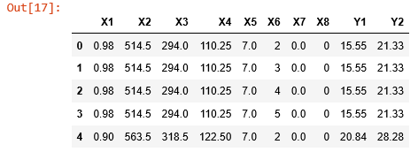
IMPLEMENTATION
The data is imported and loaded into the code.

Slide 8
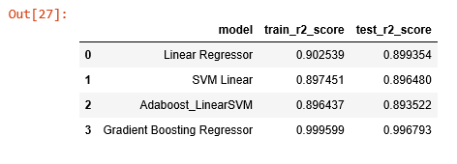
The regressors which are used in the project are linear regressor, Linear SVM, ada boosted linear SVM and gradient boosting regressor. Gradient boosting regressor has performed better than all the other regressors.

Slide 9
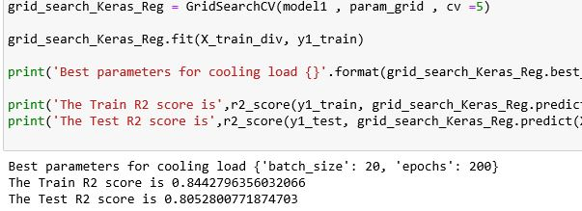
RESULTS
Prediction for heating load and cooling load.

Slide 10
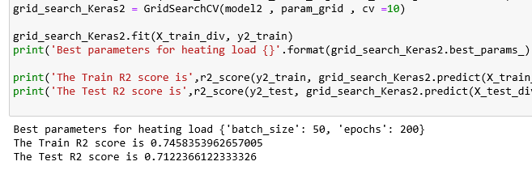
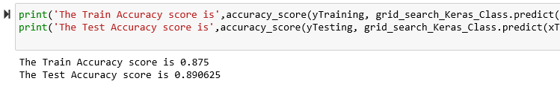

Slide 11

THANK YOU

